Slide 1
Spring Chinook Salmon in the Portland Metro Area
Jenny Kaylor, Josh Williams, Jay Hastings, Erica Fisher , and Courtney Muhlbach

Slide 2
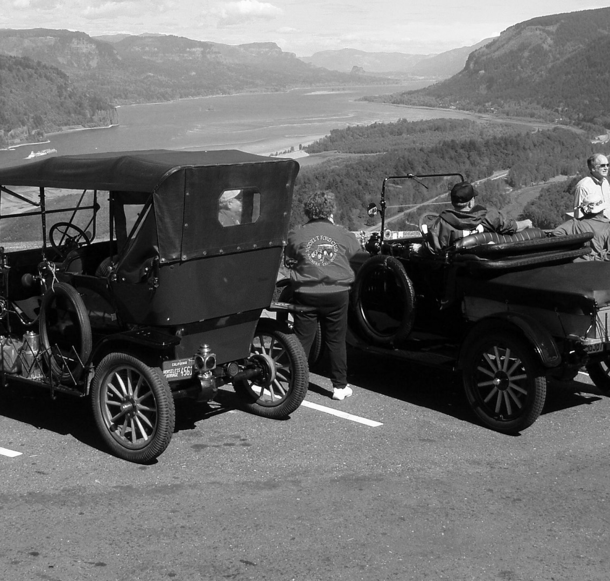
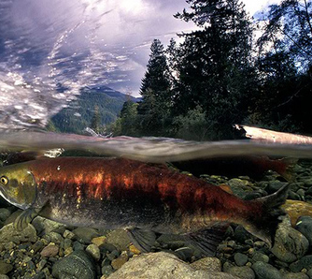
Background
Salmon
Rivers
Cities
Dams
Oh My!
Notes:
Salmon facts:
Salmon like a very narrow range of temperatures
The Columbia River is one of the world’s largest hydropower systems
There are over 450 dames throughout the entire Columbia River system
The Chinook salmon of the Columbia River has been classified as an endangered species
Many factors affect the water temperature/Snow pack/Population/Pollution/Gage
Young juvenile salmon or smolts seem to like warmer water, unless it is hot outside, then they seek cooler water
In the fall juvenile salmon move downstream to avoid colder water upstream
Spring chinook are even more sensitive than a lot of other fish
During the spawning migration, temperature is a critical environment factor. High water temps can delay or even halt fish migration
Spring Chinook like to spawn in May-June and the ideal temp is 40-50 degrees f
If the chinook salmon is shocked thermally (unideal temp) it will often be preyed upon by larger fish

Slide 3
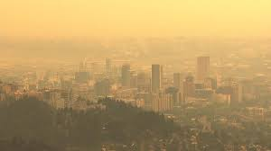
Hypothesis
Does urban growth have an affect on the salmon population?

Slide 4

Motivation and Summary: Spring Chinook Salmon vs. Water Relationship
Notes:
Our motivation was to find a correlation between the “2008-2019” water’s effect on the Native Chinook Salmon Populations in the “Lower Columbia” area during their migration cycle to spawn in the “Spring”.
*Lower Columbia is from the Bonneville and down, Willamette Falls included.

Slide 5


Questions Asked
Will Spring Chinook Salmon be here for our grandchildren?
What data do we have?
Notes:
What are the ideal water conditions for Chinook Salmon spring spawning habitat?
Were the temperatures met between the years of 2008-2020?
Is there a correlation between the Portland Metro population and the number of salmon?
We looked at the temperature surrounding the Bonneville dam and Willamette falls as well as the gage height.
We also looked at the oxygen levels but weren’t able to pull in more than one location.
We took a look at the snow pack as well.
The best places that we were able to find the data was the USGS (US Geological Survey), NRCS (Natural Resources Conservation Services), Columbia Basin Research (DART- Data Access in Real Time), and US Census.

Slide 6

Data Clean up and Exploration
Google misery
Too many sources – is it relevant data?
Data inconsistencies – so many formats
Making sure our shapes matched up – working with teams
Scrubbing, Scrubbing, Scrubbing

Slide 7
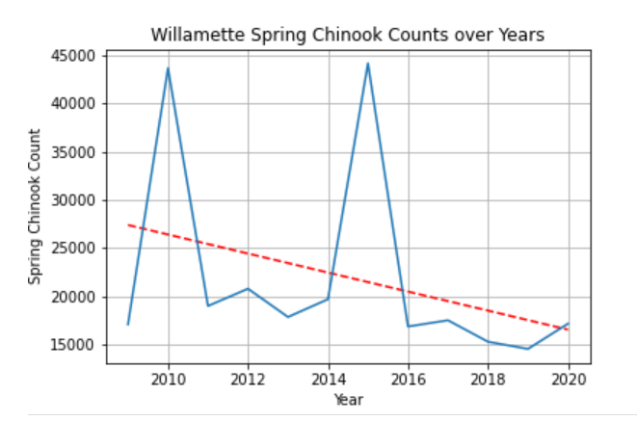
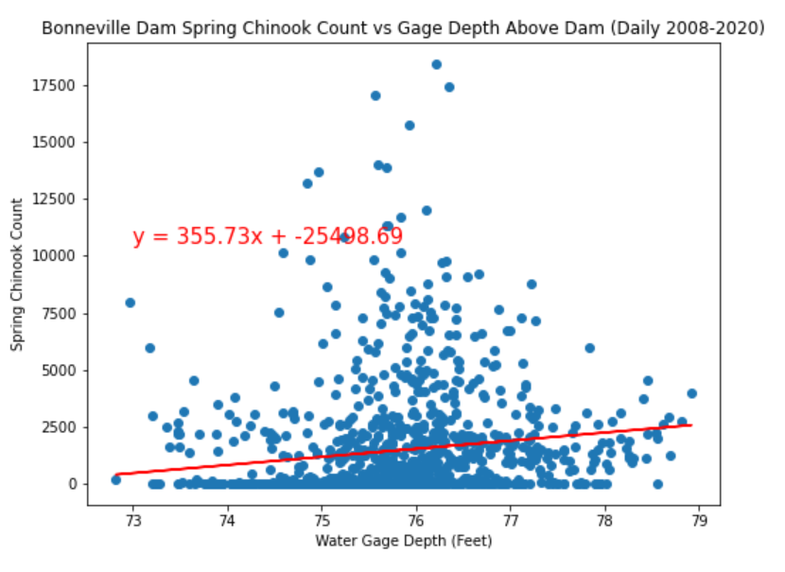
Data Analysis
Notes:
Salmon Count (Jenny)
Bonneville Above Dam (Courtney/Jenny)
-Temperature and Gage Height
Bonneville Below Dam (Jay)
-Temperature and Gage Height
Willamette Falls (Josh)
-Temperature and Gage Height
Portland Metro Population (Erica)

Slide 8
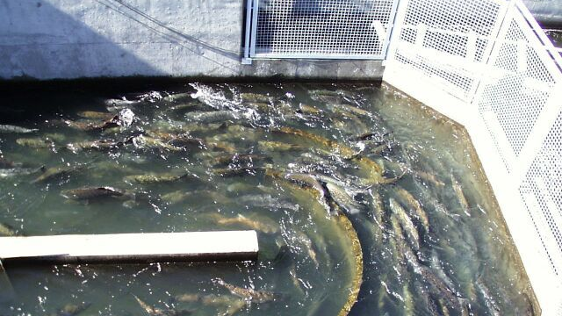
Post Mortem
Notes:
In all, we would have liked to have more time to research available data for plausible causes to the chinook salmon decline.
In consideration for future study, we would recommend comparisons to other dams in different states that the spring chinook salmon populate. We would also like to look into market trends for commercial use of salmon.

Slide 9
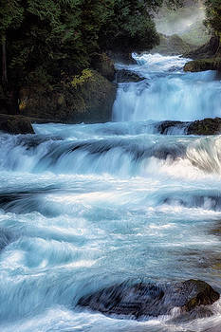
Questions?

